Slide 1
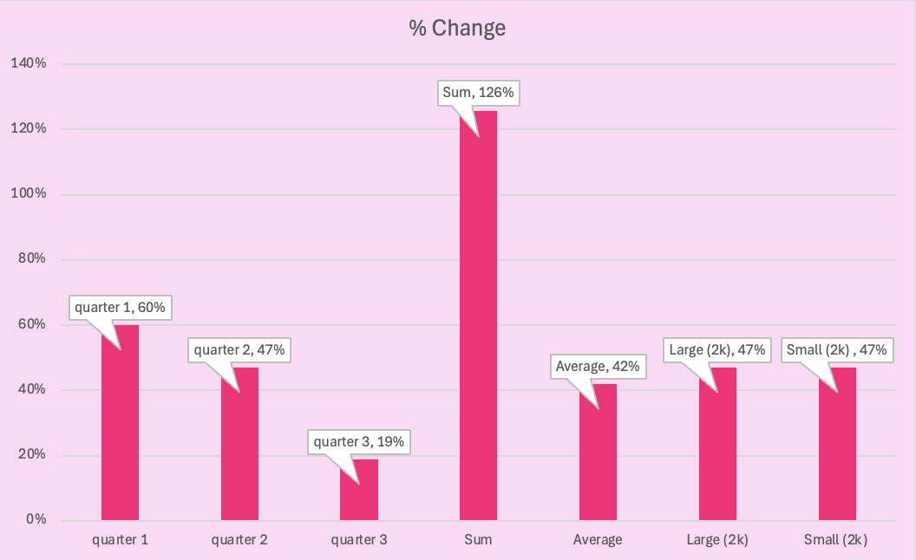
Percent Change
 | Sales LY | Sales TY | % Change
quarter 1 | $ 25,000.00 | $ 40,000.00 | 60%
quarter 2 | $ 17,000.00 | $ 25,000.00 | 47%
quarter 3 | $ 32,000.00 | $ 38,000.00 | 19%
Sum | $ 74,000.00 | $ 103,000.00 | 126%
Average | $ 24,666.67 | $ 34,333.33 | 42%
Large (2k) | $ 25,000.00 | $ 38,000.00 | 47%
Small (2k) | $ 25,000.00 | $ 38,000.00 | 47%
_________

Slide 2
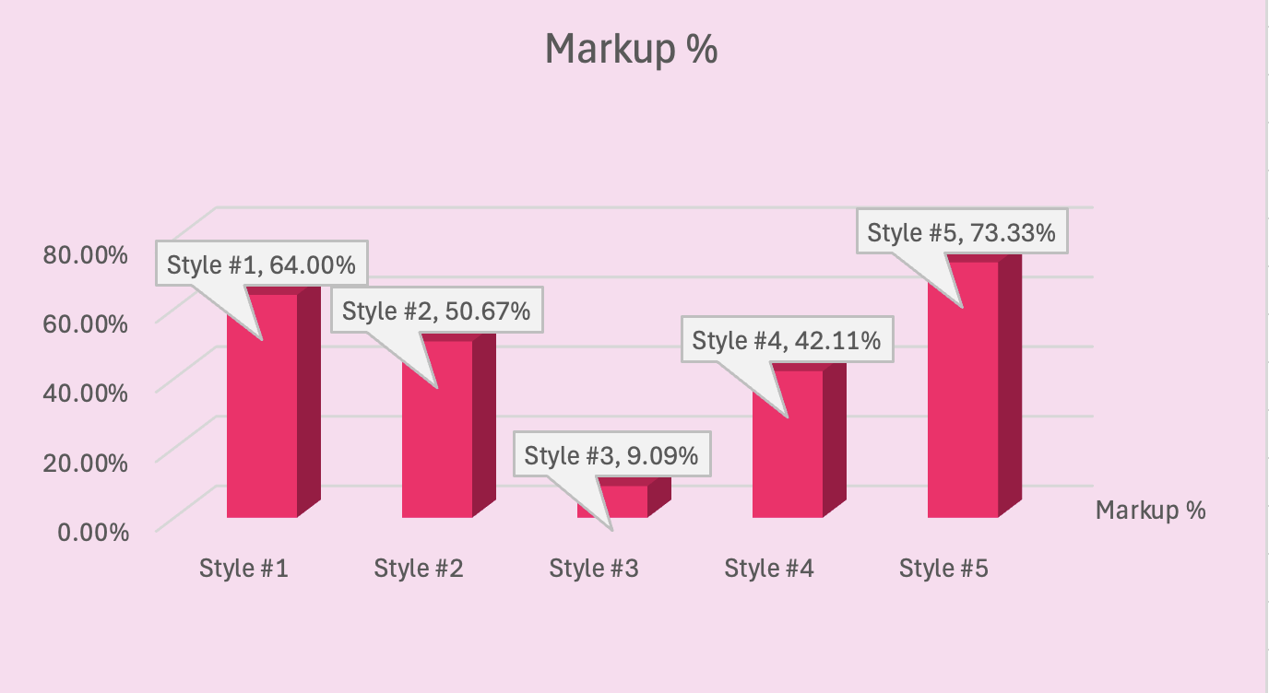
Pricing
 | $Cost | $Retail | $Markup | Markup %
Style #1 | $ 9.00 | $ 25.00 | $ 16.00 | 64.00%
Style #2 | $ 37.00 | $ 75.00 | $ 38.00 | 50.67%
Style #3 | $ 100.00 | $ 110.00 | $ 10.00 | 9.09%
Style #4 | $ 55.00 | $ 95.00 | $ 40.00 | 42.11%
Style #5 | $ 200.00 | $ 750.00 | $ 550.00 | 73.33%
____

Slide 3
Turnover
Average | $ 23,846.15
Sales | $ 50,000.00
Turnover | 2.10
 | BOM | EOM
January | $ 25,000.00 | $ 24,000.00
February | $ 24,000.00 | $ 27,000.00
March | $ 27,000.00 | $ 22,000.00
April | $ 22,000.00 | $ 23,500.00
May | $ 23,500.00 | $ 23,500.00
June | $ 23,500.00 | $ 22,000.00
July | $ 22,000.00 | $ 20,000.00
August | $ 20,000.00 | $ 22,000.00
September | $ 22,000.00 | $ 24,000.00
October | $ 24,000.00 | $ 25,000.00
November | $ 25,000.00 | $ 20,000.00
December | $ 20,000.00 | $ 32,000.00
_____

